Slide 1
RHODOPHYTA

Slide 2
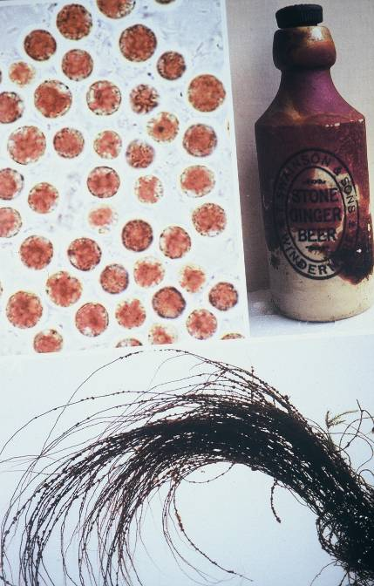
Rhodophyta 1. Bangiophyceae: links boven: Porphyridium: ééncellig, coccaal, met stervormige plast en pyrenoïde; Florideophyceae: rechts boven: Hildenbrandia: korstvormig, op fles; onder: Lemanea.

Slide 3
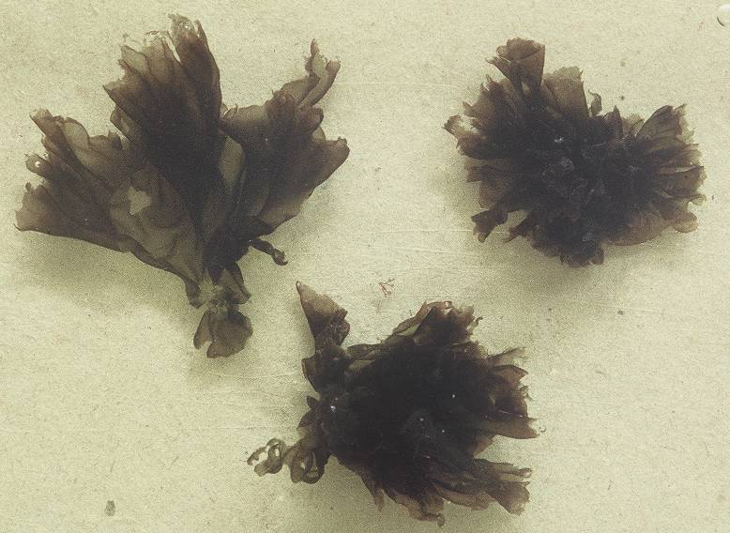
Rhodophyta 2. Bangiophyceae: Porphyra umbilicalis, purperwier: habitus: 10 cm groot, membraneus (1-lagig) (Wimereux).

Slide 4
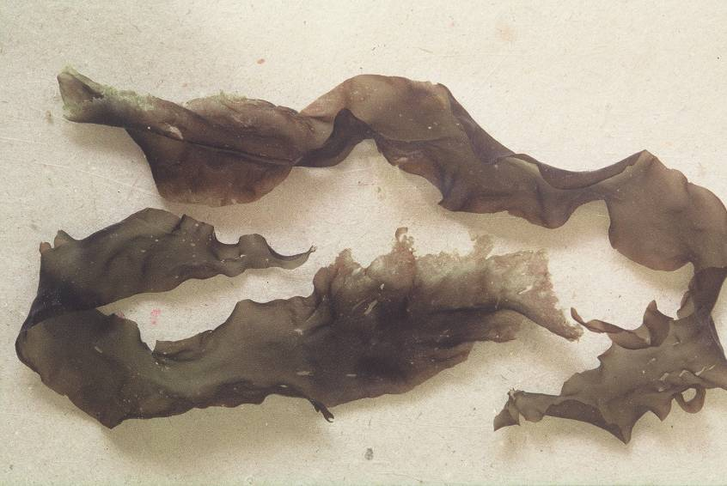
Rhodophyta 3. Bangiophyceae: Porphyra purpurea: habitus: 30 cm lang (Wimereux).

Slide 5
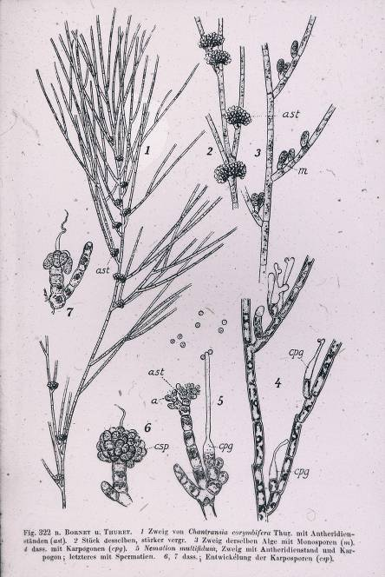
Rhodophyta 4. Florideophyceae: Acrochaetiales: Acrochaetium (= Rhodochorton, Audouinella, ...): vertakt trichaal met geslachtelijke voortplanting.

Slide 6
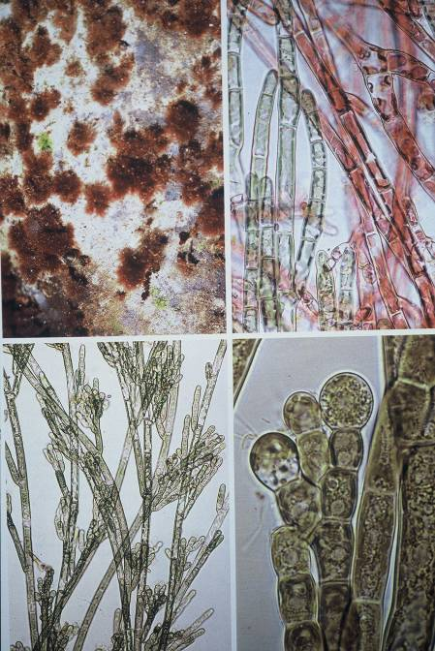
Rhodophyta 5. Florideophyceae: Acrochaetium: links boven: toefjes filamenten; rechts boven: rode (dominantie van fycoërythrine) en groene takjes (dominantie van chlorofyl a); onder: zijtakjes met monosporocysten; detail monosporo-
cysten.

Slide 7
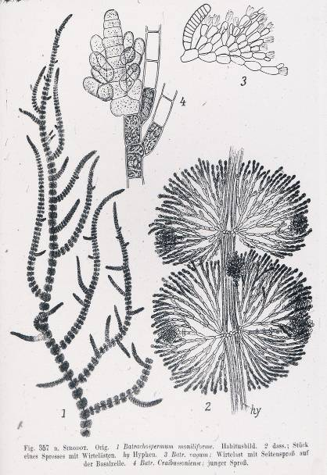
Rhodophyta 6. Florideophyceae: Nemalionales: Batrachospermum (kikkerdrilwier): uniaxiaal met kransen van zijtakken.

Slide 8
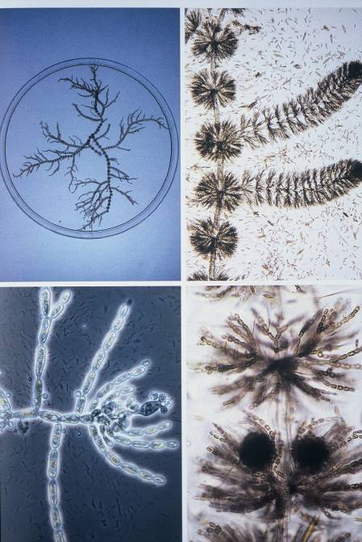
Rhodophyta 7. Florideophyceae: Nemalionales: Batrachospermum: boven: habitus (+ detail); onder links: bevruchting van het carpogonium door spermatia; onder rechts: gonimoblasten (= naakte carposporofyt).

Slide 9
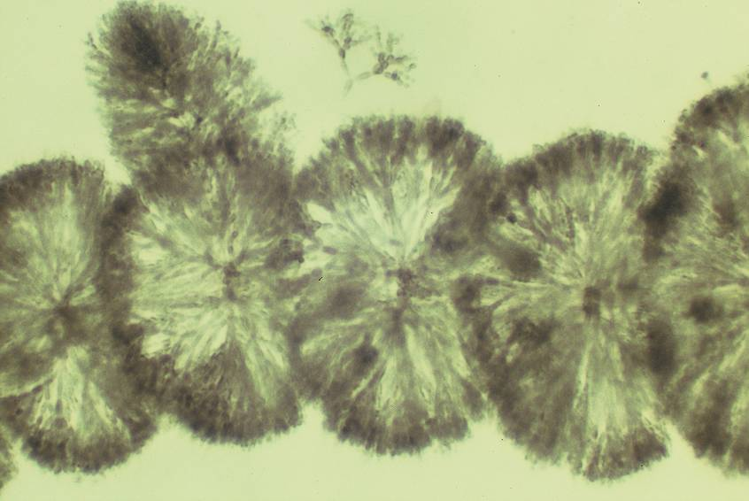
Rhodophyta 8. Florideophyceae: Nemalionales: Batrachospermum: anatomie detail: centrale as (uniaxiaal type) en kransen van zijtakken.

Slide 10
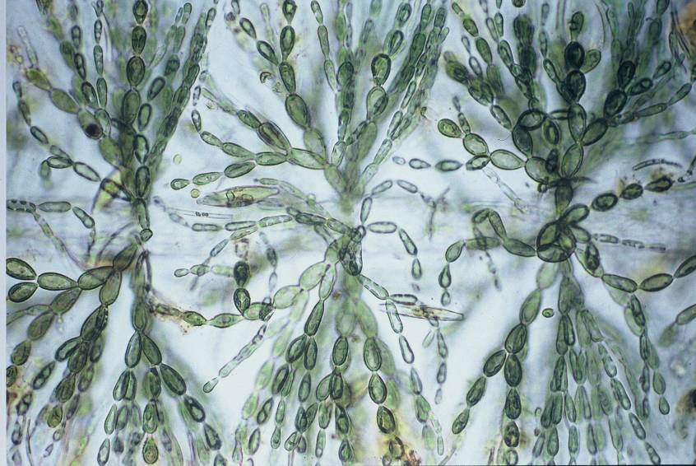
Rhodophyta 9. Florideophyceae: Nemalionales: Batrachospermum: anatomie detail: centrale as (uniaxiaal type) en kransen van zijtakken.

Slide 11
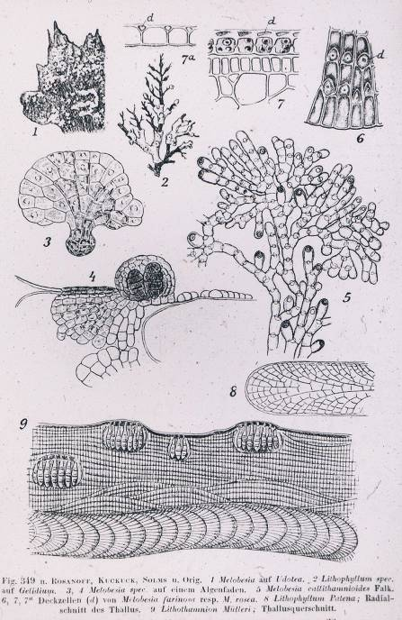
Rhodophyta 10. Diverse Corallinales (kalkroodwieren).

Slide 12
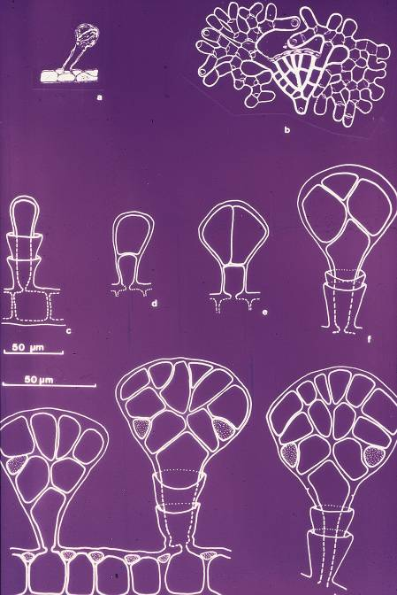
Rhodophyta 11. Florideophyceae: Corallinales. Hydrolithon farinosum: propagulen in diverse stadia (vegetatieve vermenigvuldiging).

Slide 13
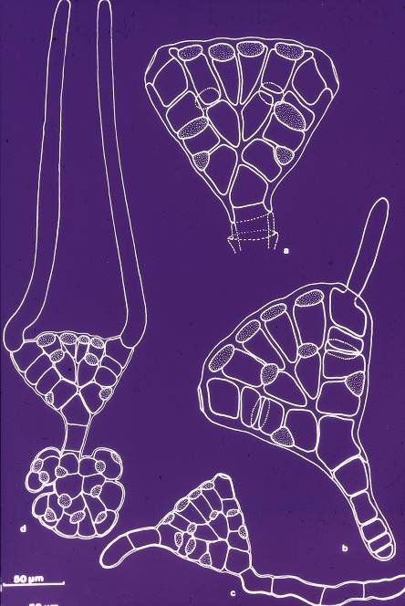
Rhodophyta 12. Florideophyceae: Corallinales. Hydrolithon farinosum: propagulen in diverse stadia (vegetatieve vermenigvuldiging).

Slide 14
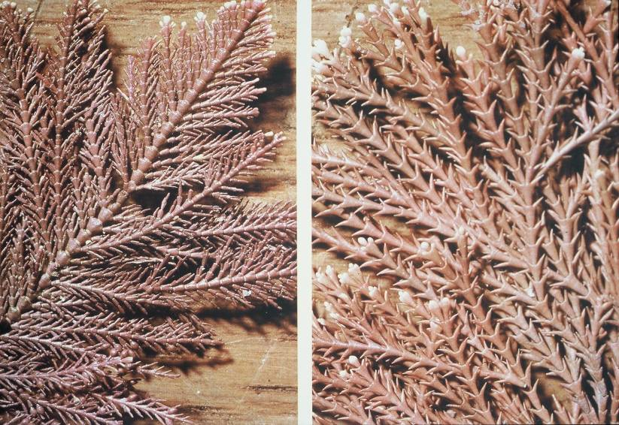
Rhodophyta 13. Florideophyceae: Corallinales. Gelede vertegenwoordigers: links: Corallina officinalis, rechts: Cheilosporum sagittatum (Australië).

Slide 15
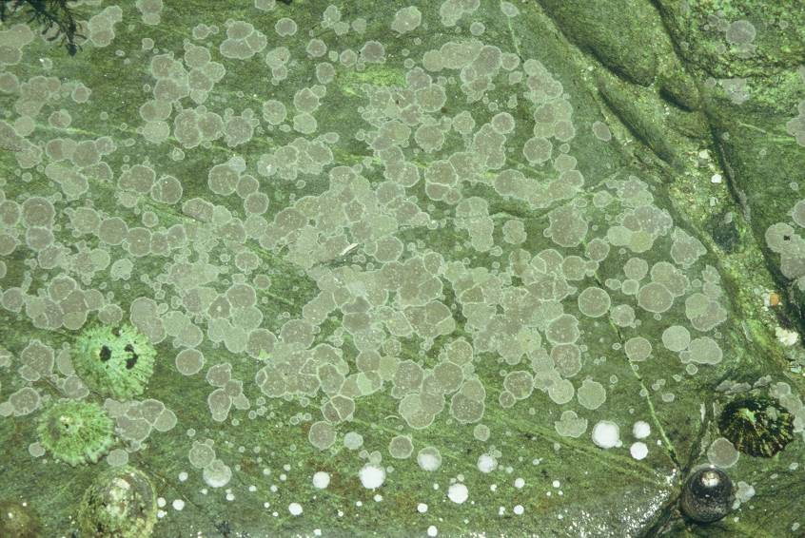
Rhodophyta 14. Florideophyceae: Corallinales. Korstvormige vertegenwoordiger: Phymatolithon lenormandii op rots (Bretagne).

Slide 16
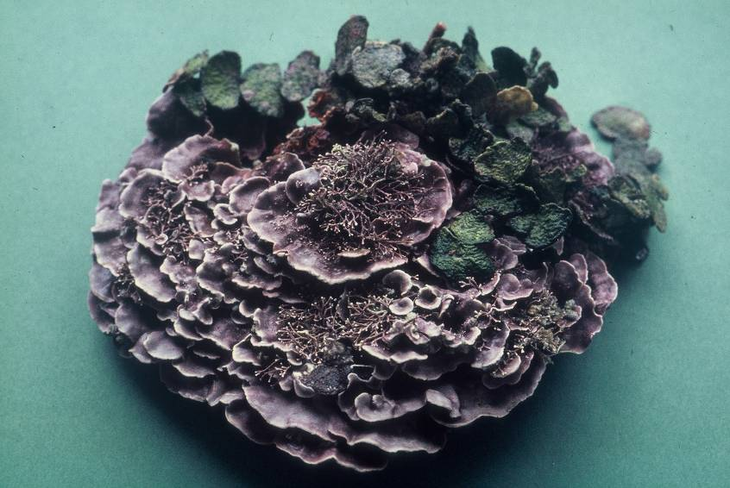
Rhodophyta 15. Florideophyceae: Corallinales. Pseudolithophyllum expansum (met epifytische Halimeda): vormt op grote diepte (>50 m) uitgestrekte complexen, het “coralligène” (Middellandse Zee).

Slide 17
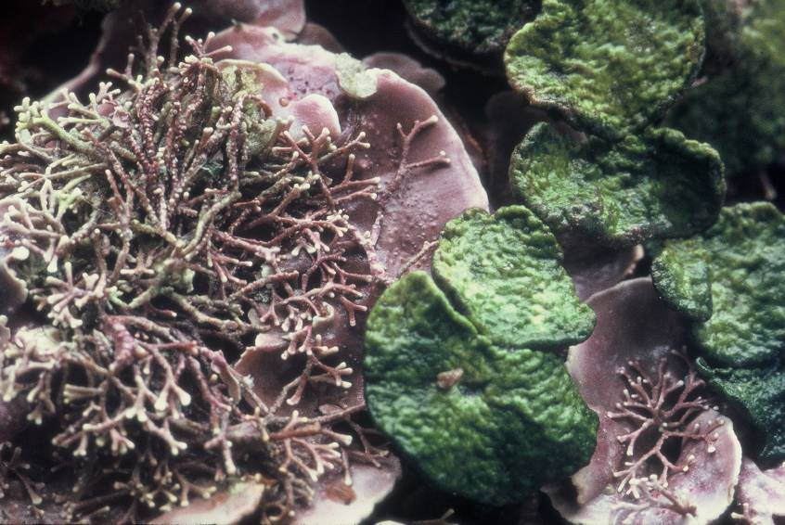
Rhodophyta 16. Florideophyceae: Corallinales. Pseudolithophyllum expansum (detail), met epifytische Amphiroa (gelede Corallinaceae) en Halimeda.

Slide 18
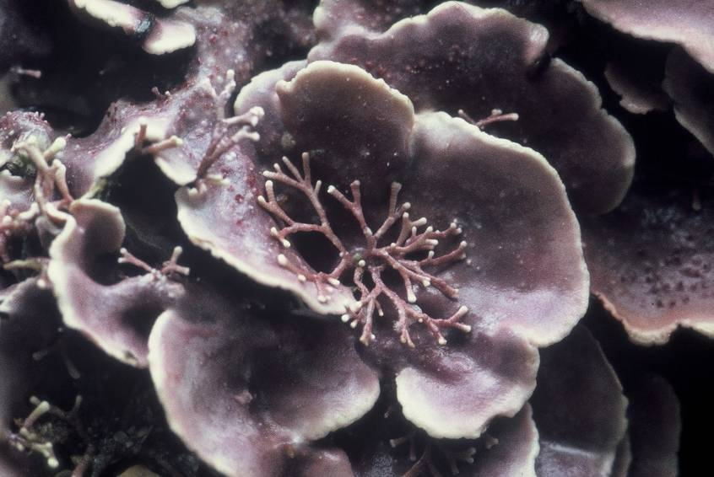
Rhodophyta 19. Florideophyceae: Corallinales. Pseudolithophyllum expansum (detail), met epifytische Amphiroa (gelede Corallinaceae).

Slide 19
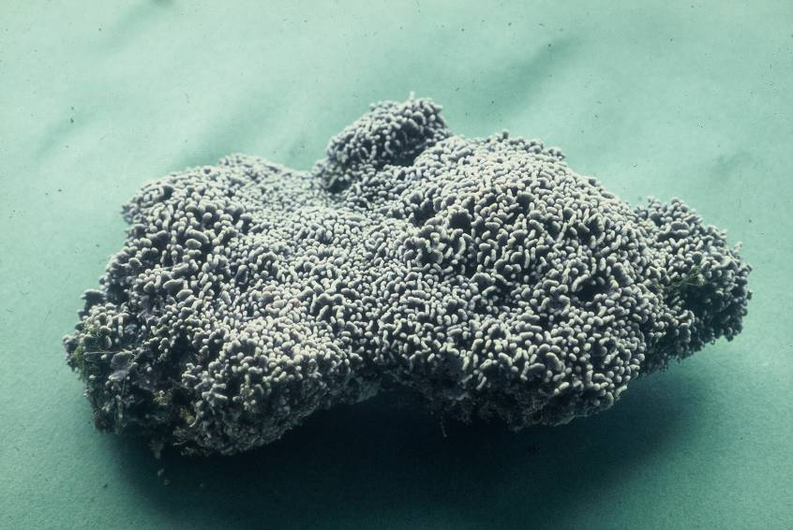
Rhodophyta 20. Florideophyceae: Corallinales: Lithophyllum tortuosum: vormt een kalksteenrichel (“le trottoir”) bij het hoogtij niveau, vooral op plaatsen met veel branding (Middellandse Zee).

Slide 20
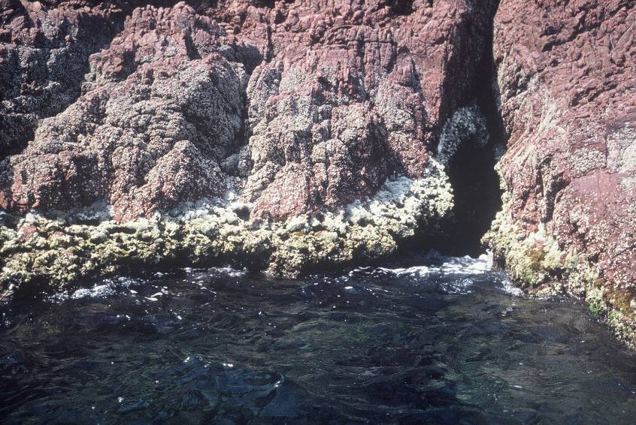
Rhodophyta 21. Florideophyceae: Corallinales: Lithophyllum tortuosum: "trottoir" (Middellandse Zee).

Slide 21
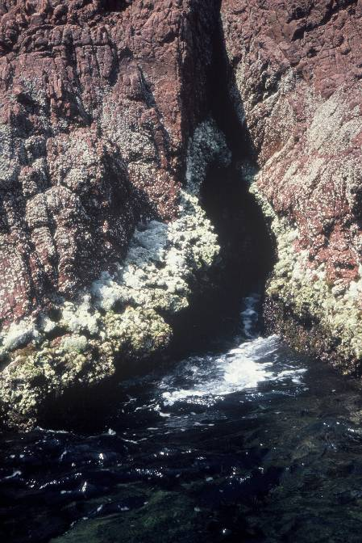
Rhodophyta 22. Florideophyceae: Corallinales: Lithophyllum tortuosum: "trottoir" Middellandse Zee.

Slide 22
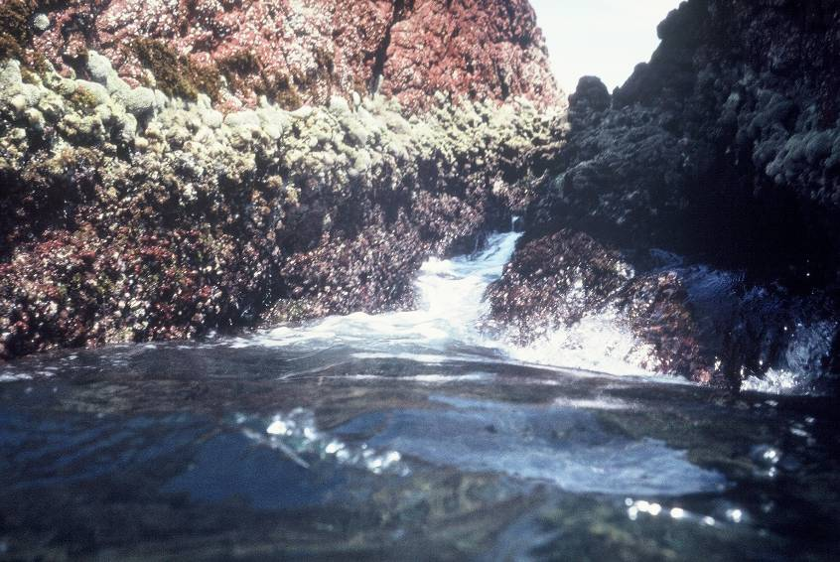
Rhodophyta 22. Florideophyceae: Corallinales: Lithophyllum tortuosum: "trottoir" Middellandse Zee.

Slide 23
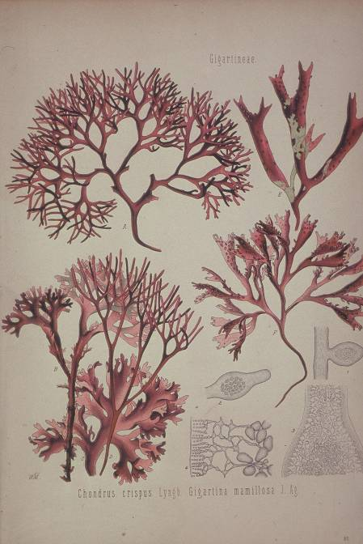
Rhodophyta 23. Florideophyceae: Gigartinales: habitus diverse genera.

Slide 24
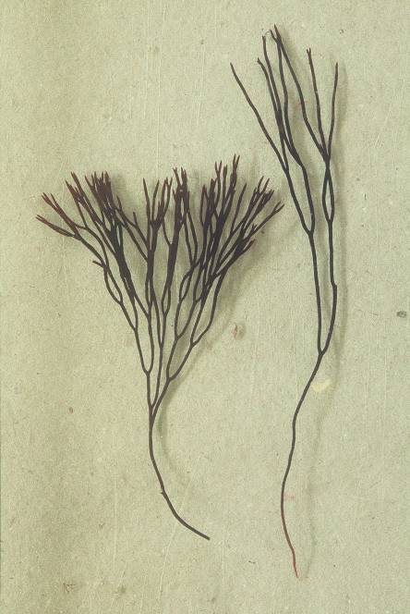
Rhodophyta 24. Florideophyceae: Gigartinales: Polyides rotundus (met hechtschijf) (Wimereux).

Slide 25
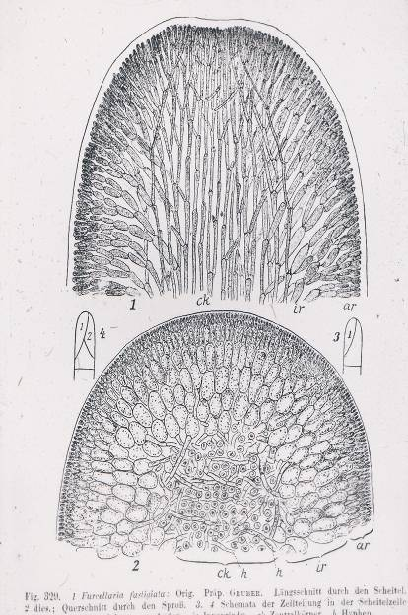
Rhodophyta 25. Polyides rotundus: dwarse (onder) en overlangse (boven) doorsnede door multiaxiale thallus (fonteintype).

Slide 26
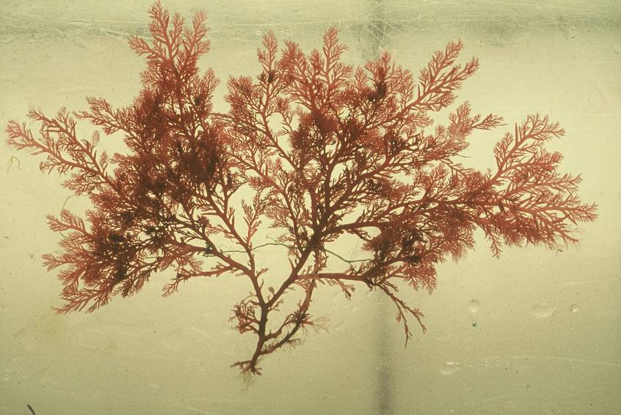
Rhodophyta 26. Florideophyceae: Gigartinales: Plocamium cartilagineum (kamwier, Wimereux).

Slide 27
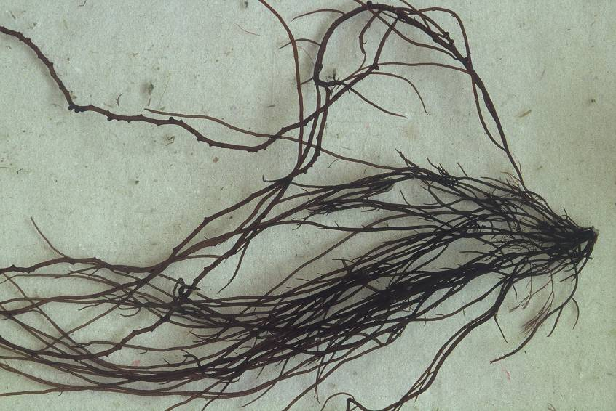
Rhodophyta 27. Florideophyceae: Gracilariales: Gracilaria gracilis: knoopwier (Wimereux). De knobbeltjes zijn cystokarpen.

Slide 28
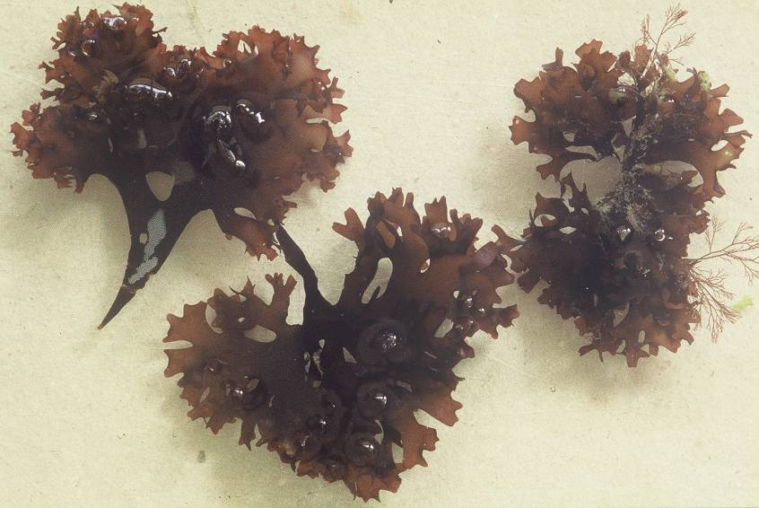
Rhodophyta 28. Florideophyceae: Gigartinales: Chondrus crispus:
Iers mos (Wimereux).

Slide 29
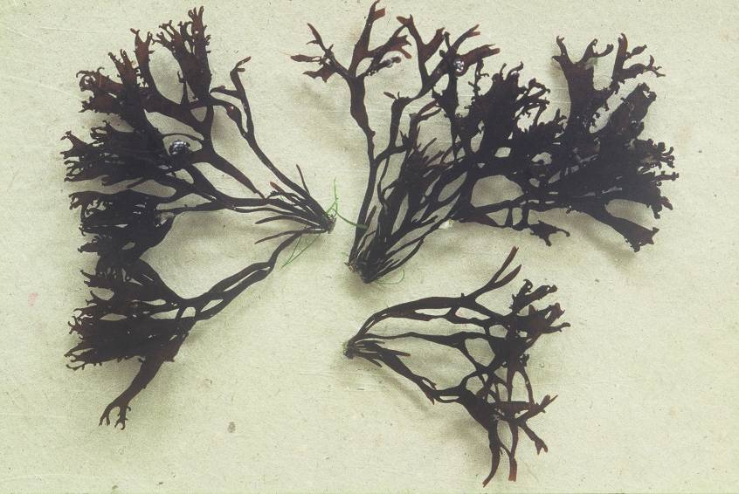
Rhodophyta 29. Florideophyceae: Gigartinales: Mastocarpus stellatus: Kernwier (Wimereux).

Slide 30
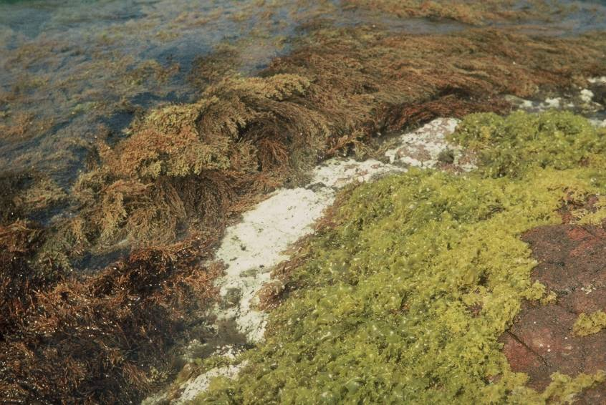
Rhodophyta 30. Florideophyceae: Gigartinales: Rissoella verruculosa (Middellandse zee): vormt een vegetatieband ter hoogte van de hoogwaterlijn; lager: Cystoseira, een bruinwier, O. Fucales.

Slide 31
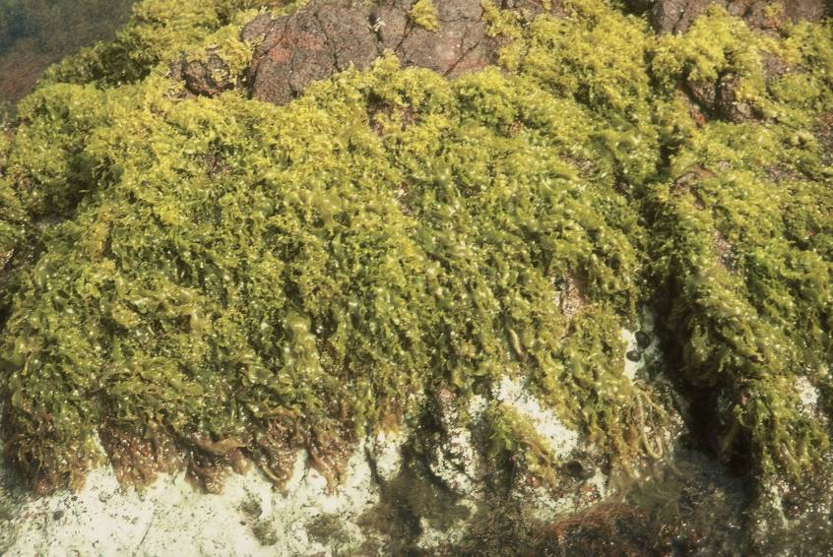
Rhodophyta 31. Florideophyceae: Gigartinales: Rissoella verruculosa: detail (Middellandse zee: vegetatie).

Slide 32
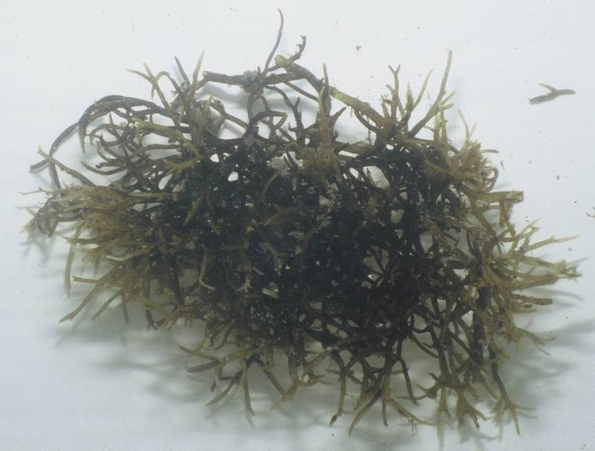
Rhodophyta 32. Florideophyceae: Gigartinales: Eucheuma sp. (Kappaphycus) (Kenya).

Slide 33
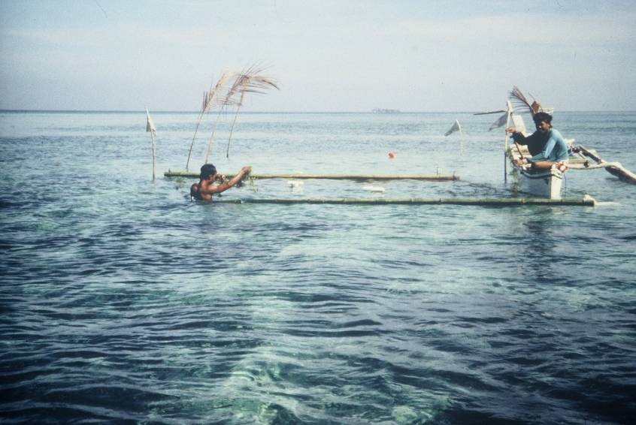
Rhodophyta 33. Maricultuur van Eucheuma in Indonesië: bamboevlotters met touwen.

Slide 34
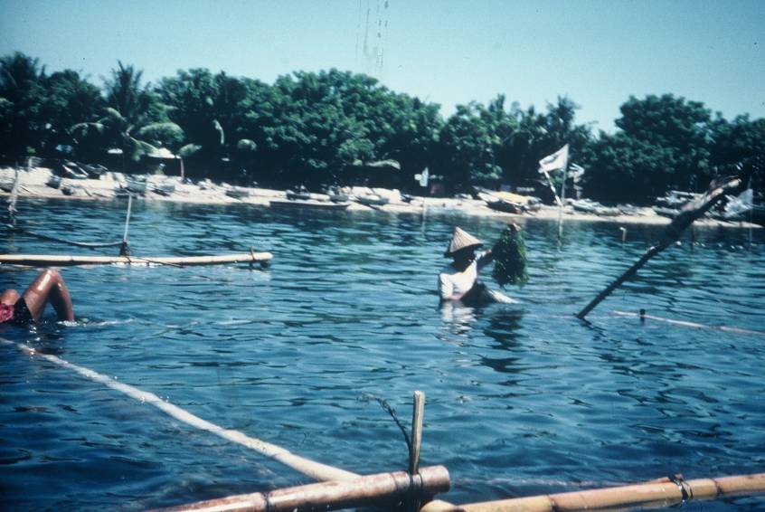
Rhodophyta 34. Maricultuur van Eucheuma in Indonesië: bamboevlotters met touwen.

Slide 35
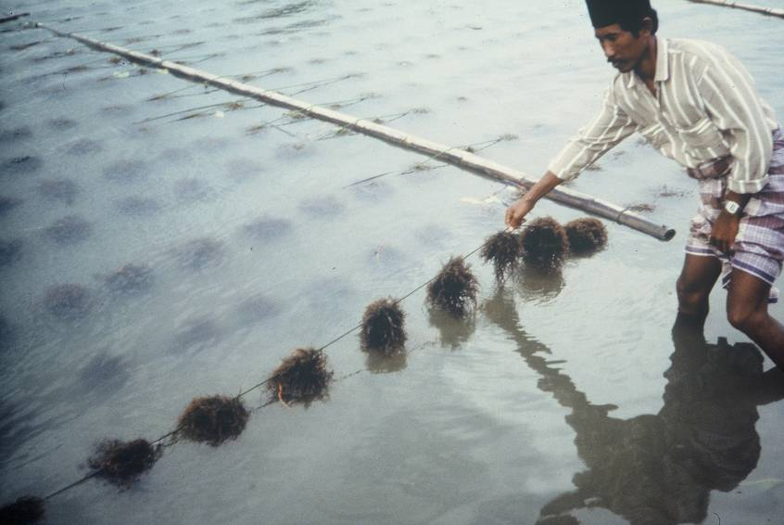
Rhodophyta 35. Maricultuur van Eucheuma in Indonesië: touwen met vastgeknoopte Eucheuma.

Slide 36
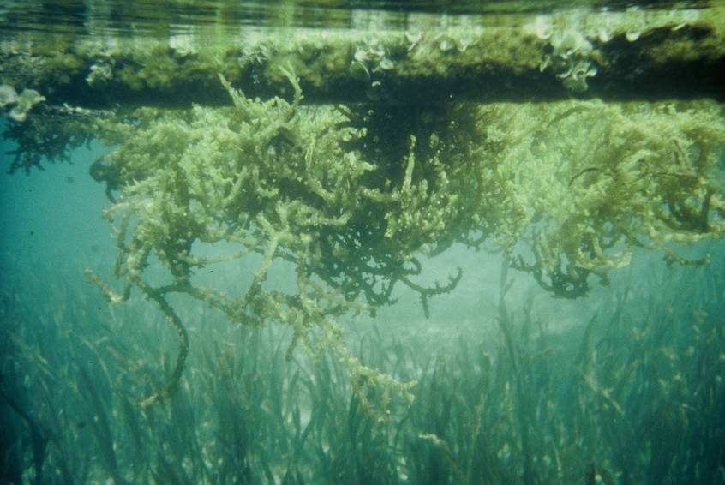
Rhodophyta 36. Maricultuur van Eucheuma in Indonesië: onderwaterbeeld van de Eucheuma (op zeebodem: zeegrassen).

Slide 37
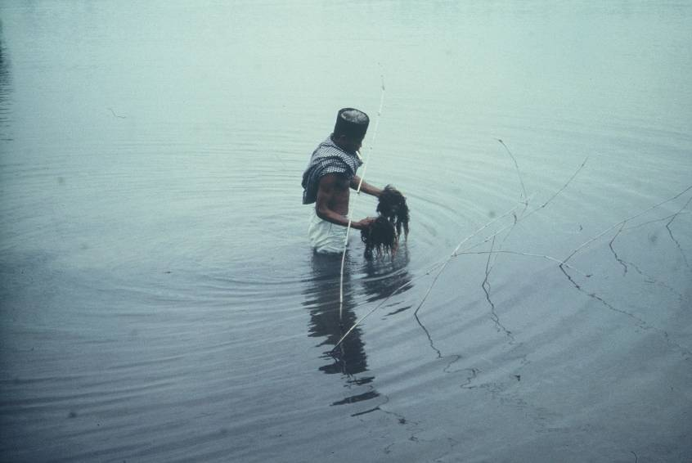
Rhodophyta 37. Maricultuur van Eucheuma in Indonesië: oogsten van de volgroeide Eucheuma.

Slide 38
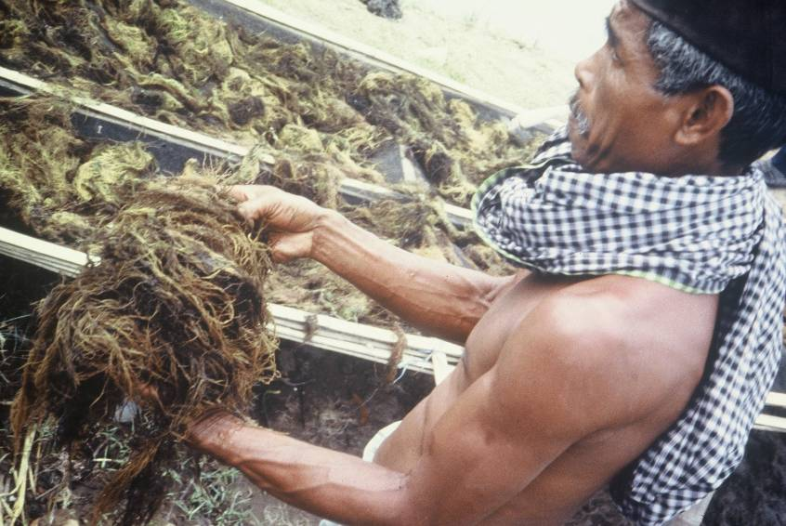
Rhodophyta 38. Maricultuur van Eucheuma in Indonesië: oogsten van de volgroeide Eucheuma: in de boten.

Slide 39
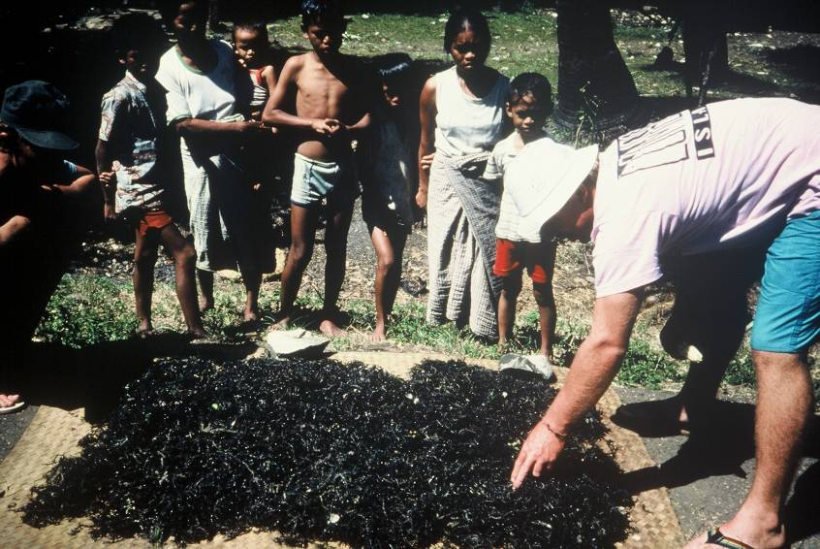
Rhodophyta 39. Maricultuur van Eucheuma in Indonesië: drogen in de zon.

Slide 40
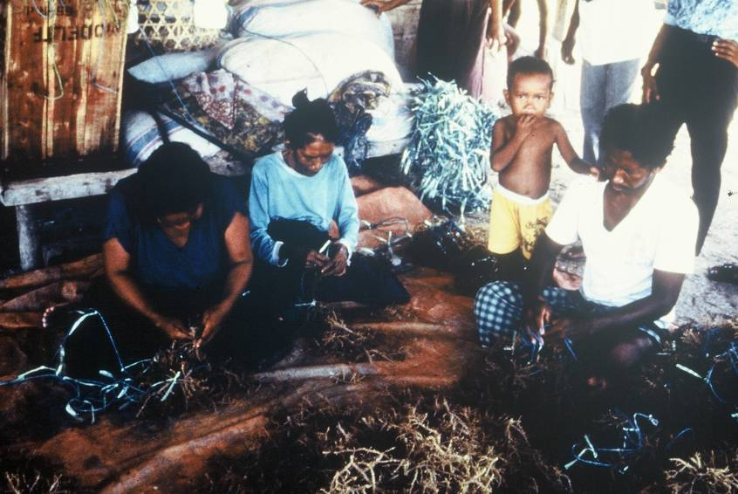
Rhodophyta 40. Maricultuur van Eucheuma in Indonesië: verpakken en vastknopen van fragmenten op touw.

Slide 41
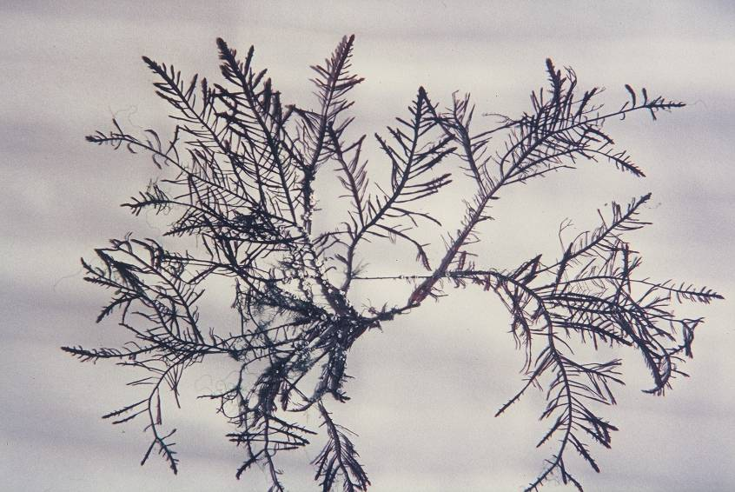
Rhodophyta 41. Florideophyceae: Gelidiales: Gelidium pulchellum (Bretagne): een agarofyt.

Slide 42
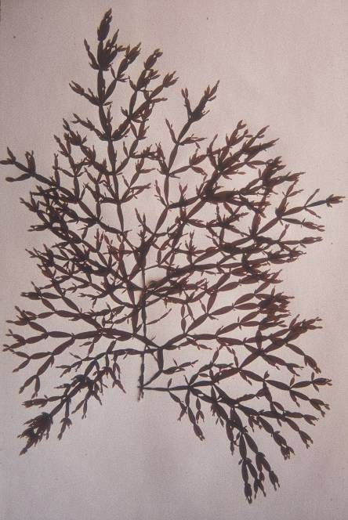
Rhodophyta 42. Florideophyceae: Rhodymeniales: Lomentaria articulata (worstjeswier) (herbariummateriaal Bretagne: verticillate vertakking).

Slide 43
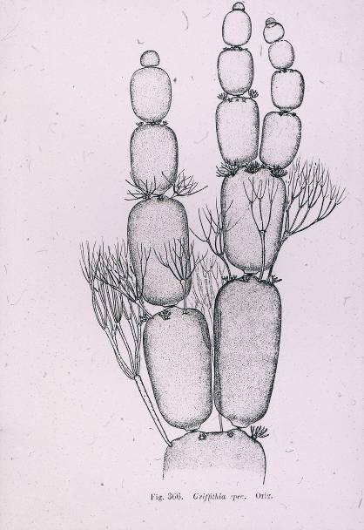
Rhodophyta 43. Florideophyceae: Ceramiales, Ceramiaceae: Griffithsia apex met trichoblasten.

Slide 44
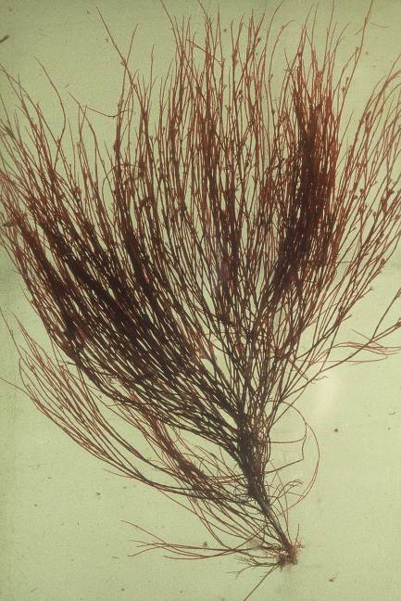
Rhodophyta 44. Florideophyceae: Ceramiales, Ceramiaceae: Halurus flosculosus (bloempjeswier, Wimereux).

Slide 45
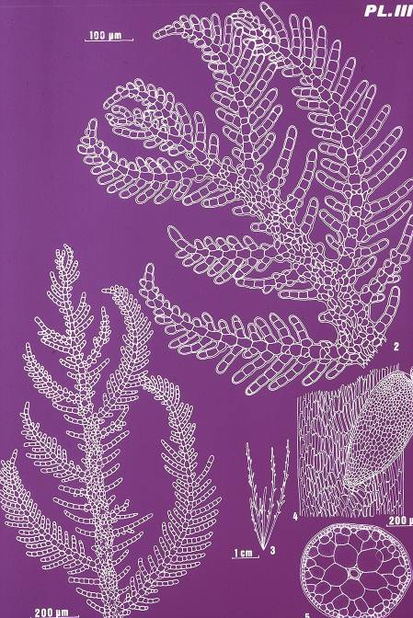
Rhodophyta 45. Florideophyceae: Ceramiales, Ceramiaceae: Plumaria plumosa.

Slide 46
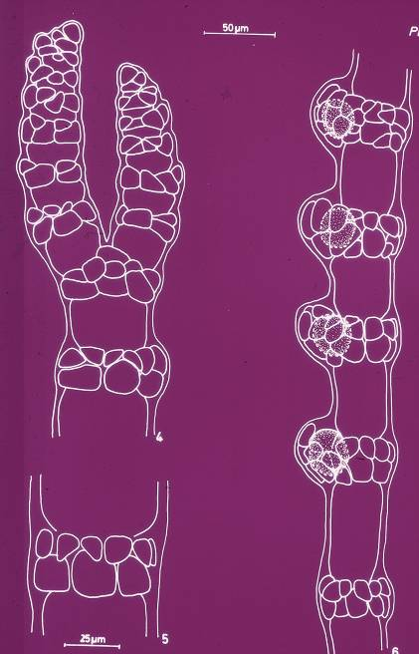
Rhodophyta 46. Florideophyceae: Ceramiales, Ceramiaceae: Ceramium tenerrimum var. brevizonatum f. repens: knopen en tussenknopen; rechts met tetrasporokysten.

Slide 47
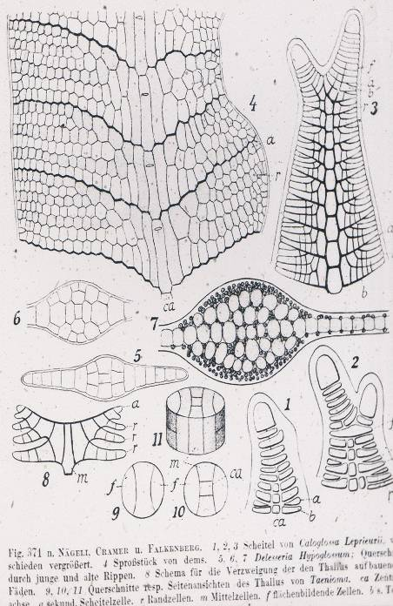
Rhdodophyta 47. Hypoglossum hypoglossoides (Tongwier): anatomie: lateraal vergroeien van zijtakjes).

Slide 48
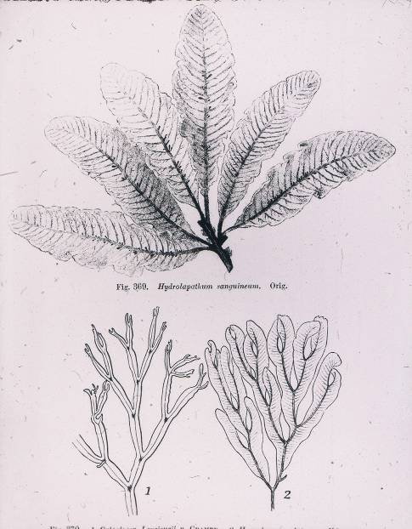
Rhodophyta 48. Florideophyceae: Ceramiales, Delesseriaceae: Delesseria sanguinea (369), Caloglossa (1), Membranoptera alata (2).

Slide 49
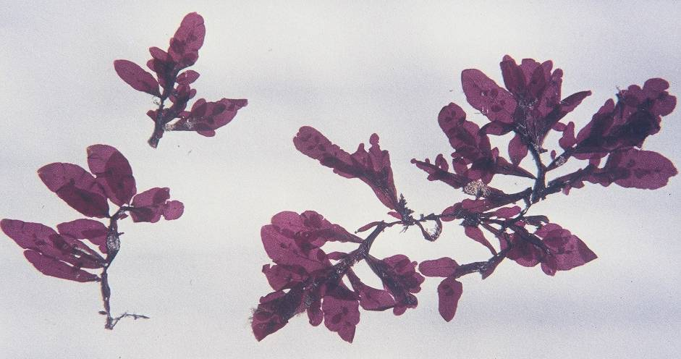
Rhodophyta 49. Florideophyceae: Ceramiales, Delesseriaceae: Apoglossum ruscifolium (herbariumspecimen Bretagne).

Slide 50
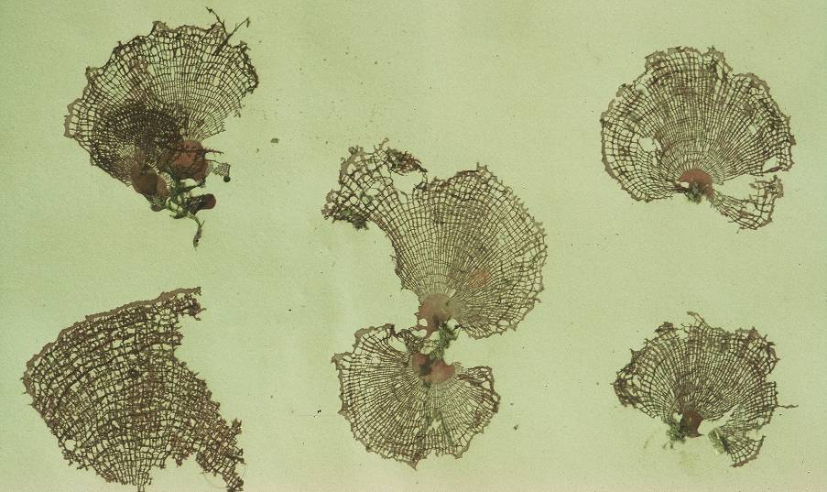
Rhodophyta 50. Florideophyceae: Ceramiales, Delesseriaceae: Martensia sp. (herbariumspecimen Papoea Nieuw-Guinea).

Slide 51
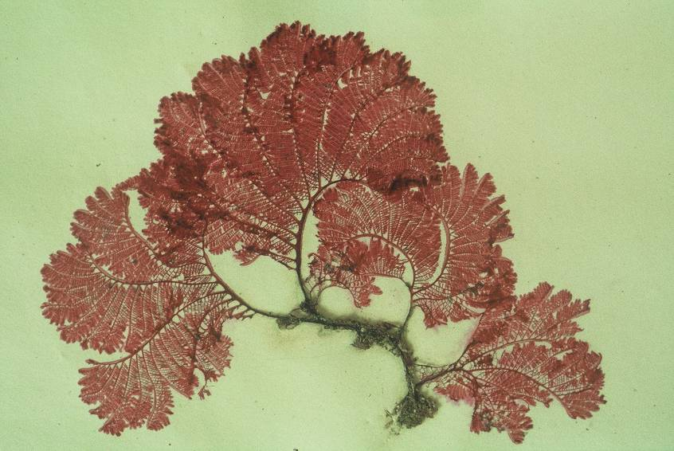
Rhodophyta 51. Florideophyceae: Ceramiales, Delesseriaceae: Zellera tawallina (herbariumspecimen Papoea Nieuw-Guinea).

Slide 52

Rhodophyta 52. Florideophyceae: Ceramiales, Rhodomelaceae: Polysiphonia (buiswier): mannelijke gametofyt met spermatangia en trichoblasten.

Slide 53

Rhodophyta 53. Florideophyceae: Ceramiales, Rhodomelaceae: Polysiphonia lanosa, epifytisch (hemi-parasitisch) op Ascophyllum nodosum (knotswier) (Wimereux).

Slide 54

Rhodophyta 54. Florideophyceae: Ceramiales, Rhodomelaceae: Polysiphonia lanosa, epifytisch (hemi-parasitisch) op Ascophyllum nodosum (knotswier) (Wimereux): detail.

Slide 55

Rhodophyta 55. Florideophyceae: Palmariales: Palmaria palmata in situ tussen Laminaria digitata en L. saccharina (Wimereux).

Slide 56

Rhodophyta 56. Florideophyceae: Palmariales: Palmaria palmata (Wimereux).

Slide 57
Ectocarpus
Dr. E. Srinivas Reddy

Slide 58
Systematic position:
Division: Algae
Class: Phaeophyceae
Order: Ectocarpales
Family: Ectocarpaceae
Type: Ectocarpus sp

Slide 59
Occurrence:
Multicellular
Filamentous
Branched
Marine brown alga.
It occures in colder seas of polar and temperate regions.
It grows abundantly on sea shore attached to rocks and stones.
Some species grow epiphytically on other algae and epizoically on the fins of fishes.

Slide 60


Thallus Structure:
The thallus is differentiated into two portions i. e.
Prostrate portion
Erect portion
Prostrate portion atttached substratum by rhioids.
Erect portion composed of many lateral branches and they have tapering ends.

Slide 61

Single cell structure:
It is composed of many retangular or cylindrical uninucleate cells.
The cells have double layered cell wall the outer is pectic in nature and inner cellulose in nature.
Protoplasm contains many discoid or band shaped or riboon like chromatophores without purenoids.
Cell organells and in addition to the reserved food complex corbohydrates

Slide 62
Reproduction:
Asexual reproduction
Sexual Reproduction

Slide 63
Asexual Reproduction:
Feverable conditions:
Plurilocular sporangia
Unilocular Sporangia.

Slide 64

Plurilocular Sporangia:

Slide 66

Unilocular sporangia:

Slide 67
Sexual Reproduction:
Un favourable conditions.
Three types:
Isogamous type
Morphological anisogamous type
Physiological anisogamous type.

Slide 68

Sexual Reproduction:

Slide 69


Slide 70

Isomorphic Alternation of Generations
(Ectocarpus)
Sporophyte (2n)
Gametophyte (n)
Spore (n)
Zygote (2n)
Gametes (n)
Fig. 14.23 in Graham et al. 2008

Slide 71


Unilocular Sporangium
Gametophyte
11
Ectocarpus
Sporophyte
Pleurilocular Gametangium
12

Slide 72


Female Gametangium
Male Gametangium
Pheremone
(= Sex Hormone)
(e.g., Ectocarpene)

Slide 73

Ectocarpus: Asexual Reproduction

Slide 74

Ectocarpus Summary
Sporophyte (2n)
Gametophyte (n)

Slide 75
Oedogonium
Dr. Srinivas Reddy

Slide 76
Classification:
Division: Algae
Class : Chlorophyceae
Order: Oedogoniales
Family: Oedogoniaceae
Genus: Oedogonium

Slide 77
Occurrence:
Multicellular
Filamantus
Un branched
Green Algae
It occures in the Standing water
Attached to substratum and freely floating mass.

Slide 78

Thallus Structure:
It is composed of a row of many cylindrical or rectangular cells.
The cells are three types:
1. Apical cell: apex and rounded.
II. Intercalary cell: between the apical and basal cell , ring like or plate like structures at the upper end called cap cells.
III. Basal Cell: it is colourless it contain hold fast. It is disc shaped or finger shaped.

Slide 79

Single cell Structure
Cylindrical or Rectangular in shape.
Cell have Double layared Cell wall.
Outer is pectic and inner is Cellulose in nature.
Protoplasm surrounded by thin membrane called plasma membrane.
Protoplasm contain Nucleus, chloroplast, other cell organale’s like mitochondria, Galgi complex, Ribosome and ER.
Reserve food material is Starch and Glycogen granules.
It contain raticulate chloroplast pyrenoids at the points of inter section.
Pyrenoids are small protein odies sourended by starch they are white in colour.

Slide 80
Reproduction
Reproduce
Vegetatively
Asexually
Sexually.

Slide 81

Vegetative Reproduction
Fragmantation
By the formation of akinetes: vegetative cells assimilate large amount of food material.
They form 10-40 chine.

Slide 82

Asexual Reproduction

Slide 83

Sexual Reproduction

Slide 84

Sex organs of Oedogonium
Antheridium:
Male sex organ.
Normal Size is called Macrandrous and reduced size is called Nanandrous species.
Protoplasm divides and re-divides and protoplasm gives male gamete or antherozoid.
Some time protoplasm fail to divide vartically and mitoticaly results in to formation of Nannandrium.

Slide 85

Oogonium
Female sex organ.
Oval shaped.
the wall of the oogonium has a small pore on the side at upper end called Receptive pore or oogonial pore
Just belo colourless spot is receptive spot.
Base cell is called supporting cell.

Slide 86

Fertilisation

Slide 87


Slide 88
Algae in Aquatic, Marine, and Terrestrial Systems
General Biology, Systematics, Ecology, and Environmental Impact

Slide 89
Algae in Aquatic, Marine, and Terrestrial Systems
Polyphyletic group: multiple genealogies
Prokaryotic algae (cyanobacteria) and Eukaryotic algae (protistans; not true plants)
Autotrophy
Body form: unicellular, filamentous, and multicellular
Diverse group: Over 26,900 eukaryotic algal species described.

Slide 90
Divisions (Phyla) of Algae
Prokaryotic Algae
  Division Cyanophyta (cyanobacteria or blue-green algae)
  not the first photosynthetic organisms, but ancient (3.5 billion years based on fossil record)
  one organelle is present in the form of simple, flattened vesicles called thylakoids (2 photosystems present)
  Chlorophyll a, phycobiliproteins; prochlorophytes are related species that possess chlorophyll a, b, and (c)
  Carbohydrate Reserve: Starch

Slide 91

Single-celled to filamentous blue-green alga or cyanobacterium

Slide 92

Colonial Cyanobacterium
Gleocapsa

Slide 93

Filamentous to semi-multicellular Cyanobacterium
Nostoc

Slide 94

Filamentous Cyanobacterium
Oscillatoria

Slide 95
Divisions of Eukaryotic Algae
Division Rhodophyta (red algae)
Division Chlorophyta (green algae)
Division Chromophyta (= Chrysophyta - golden brown algae, yellow-green algae, diatoms; and Phaeophyta - the brown algae, for example, kelps)
Division Haptophyta
Division Dinophyta (= Pyrrophyta - dinoflagellates)
Division Cryptophyta (cryptomonads)
Division Euglenophyta (Euglena spp.)

Slide 96
Photosynthetic Pigments & Food Reserves

Slide 97

Unicellular Green Alga

Slide 98


Conjugation – Sexual Reproduction

Slide 99

Filamentous Green Alga

Slide 100

Colonial Green Alga

Slide 101


Multicellular Green Algae
Ulva - sea lettuce

Slide 102

Desmid - Cosmarium

Slide 103

Diatoms

Slide 104

Dinoflagellate Algae
Cellulose-containing armor plates that give them a sculpted appearance
most species found in salt-water environments
common cause of red tides - algal blooms

Slide 105

Euglenoids

Slide 106



Red Algae
Smithora naiadum - a epiphyte on eel and surf grass
Porphyra - nori use to wrap uncooked fish & other food items
Pikea robusta

Slide 107


Brown algae
Fucus sp.
Nereocystis luekeana

Slide 108

Alaskan Kelp Forest

Slide 109
Beneficial Aspects of Algae
Food for humans
Food for invertebrates and fishes in mariculture
Animal feed
Soil fertilizers and conditioners in agriculture
Treatment of waste water
Diatomaceous earth (= diatoms)
Chalk deposits
Phycocolloids (agar, carrageenan from red algae; alginates from brown algae)
Drugs
Model system for research
Phycobiliproteins for fluorescence microscopy

Slide 110
Detrimental Aspects of Algae
Blooms of freshwater algae
Red tides and marine blooms
Toxins accumulated in food chains
Damage to cave paintings, frescoes, and other works of art
Fouling of ships and other submerged surfaces
Fouling of the shells of commercially important bivalves

Slide 111


Red tide bloom
Prorocentrum micans bloom
Associated with Hurricane Floyd, which ended a dry summer
surface of water slick with this dinoflagellate
9-21-1999

Slide 112


Algal Bloom: Before and After
9-23-1999
9-29-1999

Slide 113


Slide 114


Red Tide

Slide 115


Satellite Imagery of Red Tides

Slide 116
Toxic Phytoplankton & Human poisoning
Paralytic shellfish poisoning - saxitoxin
Neurotxic shellfish poisoning - brevetoxin
Ciguatera fish poisoning - ciguatoxin and maitotoxin
Diarrhetic shellfish poisoning - okadaic acid
Amnesic shellfish poisoning - domoic acid
Cyanobacterial neurotoxins - anatoxins
Cyanobacterial hepatotoxins - microcystin, nodularin
Dermatitis - lyngbyatoxin, aplysiatoxin

Slide 117


Bird Sudden Death Syndrome

Slide 118
Bird Sudden Death Syndrome
DeGray Lake, Arkansas; Eagles migrate to area in October and stay through March
Eagles eat fish, the American coot, and other prey items
Winter 1994-1995, 29 eagles were found dead or died of a neurological malady
Winter 1996-1997, pattern repeated itself, leaving 26 bald eagles dead
Die-off of eagles has been reported in North Carolina and Georgia
Coots have been reported to suffer similar symptoms and mortality outbreaks
Why? No one knows? Algal toxins?

Slide 119

Ch. 15 con’t Green algae and Slime mold
Green algea: Phylum Chlorophyta
Most aquatic (freshwater and marine)
Also found on snow, tree trunks, soil, lichens, sponges
Ecologically important
350 genera, 17,000 species
Resemble plants

Slide 120



They come in a wide variety of shapes and forms,
including free-swimming unicellular species, colonies, non-flagellate unicells, filaments, and more.

Slide 121




Three classes of the green algae
Chlorophyceae
Ulcophycae
Charophyceae

Slide 122


Class Chlorophyceae
Mainly freshwater few marine
Flagellated and nonflagellated unicellular
Volvox
Hollow sphere
Biflagellate vegetative cells
And nonflagellated reproductive
cells

Slide 123


Class Ulvophyceae
Primarily marine some freshwater
Filamentous of flat sheet of cells
Cladophora

Slide 124

Ulva- sea lettuce

Slide 125



Class Charophyceae
Resemble Bryophytes and Vascular plants
Spirogyra
  Ribbon like chloroplast
  No flagellated cells
  Unbranched filamentous
  Conjugation repro.
  Frothy or slimy floating masses in freshwater

Slide 126


Plasmodial slime molds
basically enormous single cells with thousands of nuclei
cytoplasmic streaming
cellular slime molds spend most of their lives as separate single-celled amoeboid protists, but upon the release of a chemical signal, the individual cells aggregate into a great swarm

Slide 127




Ch. 16 Bryophytes
Liverworts
Hornworts
Mosses

Slide 128
The Relationship of Bryophytes to Other Groups
Transitional between the charophycean green algae (charophytes) and plants ( bryophytes and vascular plants)
Both groups contain chloroplast and well developed grana
Both have motile cells that are asymmetrical with flagella that extend from the side rather than the end of the cell

Slide 129
Like the rest of land Plants, bryophytes produce an embryo- embryophytes
Evolved from green algae ancestors
Related to charophytes
Group of simple land plants
Moist habitat

Slide 130
Like other land plants, the Bryophytes:-
have multicellular sex organs, i.e. the gametes are enclosed by a sterile jacket of cells
are parenchymatous, not filamentous
retain the zygote within the female sex organ and allow it to develop into an embryo there
have cutin (a cuticle) on the plant and spores

Slide 131
Bryophytes, in contrast,
have no lignin usually
are small, low-lying, (generally) moisture-loving plants
have no roots, only filamentous rhizoids

Slide 132
THE ONLY LAND PLANTS WITH A DOMINANT GAMETOPHYTE!
The sporophyte is parasitic on the gametophyte. This stems from the embryo being retained in the female sex organ of the gametophyte.

Slide 133

Borophyte life cycle

Slide 134
As with the liverworts the plant that we commonly see is the gametophyte. It shows the beginnings of differentiation of stem and leaves - but no root like structures (rhizoids).
Mosses may have rhizoids and these may be multicellular but they do little more than hold the plant down.

Slide 135
Ecology of mosses
Mosses require abundant water for growth and reproduction.
tolerate dry spells
occupy 1% of the earth's surface (half the area of the USA).

Slide 136
There are 3 groups of Bryophytes;-
Mosses (~10,000 species)
Liverworts
Leafy liverworts (4,000-6,000 species) - predominately tropical and poorly covered in most texts
Thallose liverworts (~3,500 species) - these are further sub-divided into simple and complex thalloids
Hornworts (not covered in this course)
These are generally viewed as three monophyletic lineages emerging from the very earliest land plants.

Slide 137
Liverworts (Hepaticophyta)
About 6000 species
Two growth forms - thallose and leafy
Liverwort leaf cells each containing two to five (grey) oil bodies (as well as numerous chloroplasts).
Absorb water and nutrients through entire surface
Form single celled rhizoids for attachment
Lack stomata, but contain air pores that remain open
"Basal" group of plants, probably most like plant ancestors

Slide 138

Marchantia -
common thallose liverwort, reproduces asexually by formation of gemmae
Sporophyte usually small and short-lived
Spore dispersal facilitated by elaters (hygroscopic cells)

Slide 139

Marchantia Liverworts

Slide 140


Gemma Cups
Gametophytes of Marchantia

Slide 141
Mosses (Bryophyta)
Large group of plants - about 14,000 species
All are “leafy”, often with midvein
Produce multicellular rhizoids
Many produce stomata on sporophytes
Typically dioecious (separate male and female gametophytes)
Unbranched sporophyte with single terminal sporangium known as a capsule borne on an elongated stalk called a seta
The calyptra (gametophytic tissue) comes off and the capsule lid, the operculum, bursts off. A ring of teeth, the peristome, is hygroscopic and aids in spore dispersal. Each capsule may contain up to 50 million spores.
Spores germinate to form a filamentous protonema
Many mosses have primitive conducting cells:
Hydroids - water conducting cells
Leptoids - sap conducting cells
It is unclear wheter hydroids and leptoids are homologous or analogous to the xylem and phloem of vascular plants

Slide 142
Mosses and leafy liverworts can be confused.
Leaves of leafy liverworts never have a mid-rib (unlike those of most mosses).
Mosses have multicellular rhizoids vs. the unicellular rhizoids of liverworts
The capsules are quite different, as we will see
Moss leaves are of equal size and spirally arranged while the main leaves of liverworts are arranged in one plane on either side of the stem with a third row of smaller leaves on the underside of the stem.
Moss leaves are never lobed
Oil bodies occur in the leaves of 90% of liverworts, but are absent from moss leaves.

Slide 143

Mosses: phylum Bryophyta
Peat mosses Sphagnum
ecologically important
It grows in dense populations that form peatlands, a wetland habitat that occupies 1% of the earth's surface.
Hydrological significance, since it can hold up to 20 times its weight in water- commercially useful material in horticulture
Global carbon cycle “carbon sink”
400 billion tons of organic carbon stored
global warming will convert into a "carbon source“
accelerate global warming.

Slide 144
Hornworts: Phylum anthocerophyta
Small taxon (less than 100 species)
Tall, narrow sporophytes with indeterminate growth
Intercalary (basal) meristem in sporophyte
Form symbiotic associations with cyanobacteria
Single chloroplast per cell (important taxonomic character)
Spores have pseudoelaters
Have well-defined stomata

Slide 145
Hornwort

Slide 146

Hornwort young

Slide 147

Hornwort old

Slide 148

Reproduction
Asexual Reproduction
  involves only 1 parent
  offspring genetically identical to parent
  involves regular body cells
  its quick
Sexual Reproduction
  involves 2 parents
  offspring genetic mix of both parents
  involves specialized sex cells
  its slow
1:21

Slide 149
Asexual Reproduction
Binary fission
  happens in bacteria, amoeba, some algae
  one parent cell splits into 2 identical daughter cells
Budding
  happens in yeast, hydra, corals
  parent produces a bud
  bud gets detached and develops into offspring which is identical to parent

Slide 150


Binary Fission
Rod-Shaped Bacterium,
hemorrhagic E. coli
2 daughter cells are identical to parent

Slide 151


Budding

Slide 152
Asexual Reproduction contd.
Spore Formation
  happens in fungi, green algae, moulds and non flowering plants (e.g. ferns)
  spores are produced and each spore develops into offspring which are identical to parent
Vegetative Reproduction
  does not involve seeds
  some offspring can grow from cuttings (e.g. coleus), runners (e.g. strawberries), tubers (e.g. potatoes) or bulbs (e.g. tulips)… which are part of the parent plant

Slide 153


Spore Formation
Fern
Fungi

Slide 154





Vegetative
Reproduction

Slide 155

Sexual Reproduction in Animals
involves specialized sex cells called gametes
the union of a male and female gamete results in the formation of a zygote that develops into a new individual

Slide 156


Sexual Reproduction in Plants
Female Parts
Male Parts
(Pistil)
pollen (male) + ovule (female) → single-celled zygote → multi-celled embryo (contained in a seed) → new individual

Slide 157
Sexual Reproduction in Plants
stamen is the male part and contains pollen
carpels or pistil is the female part and contains ovule (eggs)
pollen grains from the anther are transferred to the stigma by the process of pollination
  self pollination (plant pollinates its own eggs)
  cross pollination (pollen from one plant pollinates another plants eggs)

Slide 158


Pollination
flowers are designed to lure insects to help with the pollination process
  also wind, animals, birds can transport pollen

Slide 159
Sexual Reproduction Summary
 | Male Gamete | Female Gamete | Type of Union | Result of Union | Final Result
Plants | pollen | ovule (egg) | pollination | single cell zygote | multi-cell embryo (in seed)
Animals | sperm | egg | fertilization | single cell zygote | multi-cell embryo

Slide 160


Some Organisms do Both
most plants that produce seeds (sexual reproduction) can also reproduce asexually by things like cuttings or runners
this gives them an advantage for survival
sponges and hydra
mosses
Notes:
Mosses produce asexual spores in the early part of their life cycle and then egg and sperm cells are produced in a later part of the same cycle.

Slide 161
Which is Better?
It depends!
Asexual Reproduction
advantages
  does not require special cells or a lot of energy
  can produce offspring quickly
  in a stable environment creates large, thriving population
disadvantages
  limited ability to adapt
  face massive die-off if environment changes
Sexual Reproduction
advantages
  lots of variation within a species
  able to live in a variety of environmental settings
  able to adapt to changes in the environment
disadvantages
  needs time & energy
  produce small populations

Slide 162
SEAWEEDS PART III
PHAEOPHYCEAE
MARINE BOTANY
Dr. E. Srinivas Reddy

Slide 163

CHARACTERISTICS
COMPLEX MULTICELLULAR THALLI
FUCOXANTHIN (DOMINANT PIGMENT)
HETEROKONTOUS FLAGELLATED STAGES
WALLS ARE COMPOSED OF ALGINIC ACID
(MUCOPOLYSACCHARIDE)

Slide 164
BROWN ALGAL LIFE CYCLES
Isomorphic Generation – Sporophytes (diploid phase) and gametophytes (haploid phase) are similar in structure and appearance.
Heteromorphic Generation –Dissimilar haploid and diploid phases.
Absence of a free-living haploid phase.

Slide 165

ISOMORPHIC GENERATION
Ectocarpus - Common in the colder seas of the Northern Hemisphere, these organisms have become tolerant to the metal pollution which surrounds ports and docks. Ectocarpus is one of the primitive brown algae with an isomorphic life cycle, i.e. the sporophyte and gametophyte generations are identical in appearance.
http://home.manhattan.edu/~frances.cardillo/plants/protoc/ectocarp.html

Slide 166
Ectocarpus – Isomorphic Generation
Female gametophyte------Plurilocular gametangium---gametes
Male gametophyte---Plurilocular gametangium-----gametes
fusion
meiosis
sporophyte
Haploid zoospores
Unilocular sporangium
Plurilocular
sporangium
No meiosis
Diploid zoospores

Slide 167

HETEROMORPHIC GENERATIONS
Structural complexity of the sporophyte
Reduction of the gametophytic phase
Loss of plurilocular sporangia
Biology of Algae: Sze

Slide 168

KELPS
(ORDER LAMINARIALES)
haptera
blade
Characteristics
parenchymatous thallus
heteromorphic generations
oogamous reproduction
Thallus
Blade, stipe and holdfast (haptera)
holdfast
stipe
http://www.algaebase.org

Slide 169


OTHER KELPS
SEA PALM –Postelsia
http://www.algaebase.org

Slide 170


GIANT KELP
Macrocystis
Reference: http://www.algaebase.org/search/species

Slide 171

NO GAMETOPHYTIC PHASE
FUCALES
Fucus – flattened thallus and a dichotomous branching pattern. Small cavities called cryptostomates are scattered on the surface. Cryptostomates have sterile hairs that help in the uptake of nutrients from the seawater.
cryptostomates
http://www.algaebase.org

Slide 172

Fucus
F. vesiculosus –pairs of air bladders along its thallus. These bladders provide buoyancy.
http://www.algaebase.org/search

Slide 173

Fucus
Fucus has reproductive regions, called receptacles, located at the ends of its branches. Just below the surface of a receptacle are conceptacles. They are spherical cavities in which gametes are produced.
Receptacle
http://www.algaebase.org/search/species

Slide 174

Fucus
Female Conceptacle
Male Conceptacle
http://www.algaebase.org/search/species

Slide 175
USES OF KELPS
The primary known constituents of Kelp include algin, iodine, potassium, bromine, mucopolysaccharides, mannitol, alginic acid, kainic acid, laminine, histamine, zeaxanthin, protein, and Vitamins B-2 & C.
The seaweed Kelp (Fucus vesiculosis) is an excellent source of minerals from the sea, particularly iodine which is very important for the thyroid gland to function properly.

Slide 176
USES OF KELPS
Kelp is known for the following properties: antibacterial, antioxidant, diuretic, expectorant, and nutritive, and is generally available in the forms of tea and capsules.
kelp have a link to a lower breast cancer rate; less obesity, heart disease, rheumatism, arthritis; lower blood pressure; less thyroid disease; less constipation and gastro-intestinal ailments and less infectious disease. Kelp provides nutritional support to the nervous system and heart in the form of iodine, vitamins, minerals and salts.

Slide 177






Algae
An Overview

Slide 178
Characteristics
Range in size from microscopic to single celled organisms to large seaweed
Autotrophic
Form the reproductive structures – gametangia or gamete chambers
Aquatic and have flagella at some point in life
Often contain pyrenoids, organelles that synthesis and store starch

Slide 179
STRUCTURE
Thallus (haploid)
Four types of algae
  Unicellular
  Colonial
  Filamentous
  multicellular

Slide 180



IDENTIFY THE TYPE OF ALGAE

Slide 181
CLASSIFICATION OF ALGAE
SEVEN PHYLUM BASED ON
  COLOR
  TYPE OF CHLOROPHYLL
  FOOD-STORAGE SUBSTANCE
  CELL WALL COMPOSITION

Slide 182

REPRODUCTION
MOST REPRODUCE BOTH SEXUALLY AND ASEXUALLY
  Most sexual reproduction is triggered by environmental stress
  Asexual Reproduction
    Mitosis
  Sexual Reproduction
    Meiosis
    Zoospores
    Plus and minus gametes
    Zygospore

Slide 183

Reproduction in Multicellular Algae
Oedogonium reproduction
  Antheridium-release flagellated sperm that swim to the oogonium
  Oogonium-houses the zygote which is a diploid spore
    The spore undergoes meiosis and produces 4 haploid zoospores. One of the four cells becomes a rootlike holdfast the others divide and become a new filament.
oogonium

Slide 184

holdfast

Slide 185
Spirogyra reproduce sexually by conjugation

Slide 186
Ulva Reproduces by Alternation of Generations
Two distinct multicellular phases- one is haploid and the other is diploid
  Gametophyte is haploid
  Sporophyte is diploid

Slide 187
Phylum Chlorophyta
Green algae
7000 diverse species
Biologist reason that green algae give rise to land plants.
Both green algae and land plants have chlorophyll a and B as well as carotenoids and store food as starch
Both have walls made of cellulose

Slide 188
Phylum Phaeophyta
1500 species of Brown algae
Mostly marine and include seaweed and kelp
All are multicellular and large (often reaching lengths of 147 feet)
Individual alga may grow to a length of 100m with a holdfast, stipe and blade
Used in cosmetics and most ice creams

Slide 189
Phylum Rhodophyta
4000 species of RED Algae
Most are marine
Smaller than brown algae and are often found at a depth of 200 meters.
Contain chlorophyll a and C as well as phycobilins which are important in absorbing light that can penetrate deep into the water
Have cells coated in carageenan which is used in cosmetics, gelatin capsules and some cheeses

Slide 190

Phylum Euglenophyta
1000 species of Euglenoids
Have both plantlike and animal-like characteristics
Fresh water

Slide 191



Other Phylum Representatives
Diatoms – used in detergents, paint removers, toothpaste
Dinoflagellates – red tides
Golden algae
Important in the formation of petroleum products

Slide 192


Funguslike Protist
Cellular Slime molds

Slide 193
Plasmodial Slime Molds

Slide 194

Water Molds

Slide 195
Batrachospermum
Dr. E. Srinivas Reddy

Slide 196
Classification
Division: Rhodophyta
Class: Rhodophyceae
Order: Nemalionales
Family: Batrachospermeaceae
Genous: Batrachospermum spe.

Slide 197
Occurrence
Multicellular
Filamentous
Branched
Red alga.
It occurs in the fresh, well aerated water of ponds, lakes etc.

Slide 198
Thallus structure:
Moniliform thallus composed of short nodes alternating with long internodes i. e.
Branches of limited growth
Branches of unlimited growth
The clusters of short laterals are called as the glomerules and they give moniliform structure.
Glomerules bear the sex organs and also white coloured ball like fruiting bodies called Cystocarps or Carposporophytes.
The main thallus of Batrachospermum is surrounded by certain out growths or filaments called the cortical filaments.

Slide 199

Single cell Structure:
Cell wall the Outer is Pectic and inner is cellusose in nature.
Central large vocule
Many discoid chromatopores with a single pyrenoid.
Chromatophores have coloured pigments like Phucoerythrin-c, Phycocyanin-c, Xanthophylls, Carotene and Chlorophyll etc.
Complex carbohydrates like Floridean starch

Slide 200
Reproduction:
Asexual reproduction takes place by means of monospores.
Sexual reproduction is of advanced oogamous type.
Species of Batrachospermum are either monoecious or dioecious.
The male reproductive structures are called spermatangia or antheridia and the female carpogonia.

Slide 201

Spermatangia
Male sex organ it is small, Uninucleate, rounded or spherical thick walled, colourless structure.
Spermatangial growth in the glomerule called the spermatangial branch or antheridial branches.
When the spermatangia mature the content metamorphoses into a single very small, non motile naked colourless protoplasmic mass called the spermatium or male gamate or sperm.

Slide 202

Carpogonium:
Female sex organ, flask shaped structure with basal swollen portion and distal elongated narrow portion.
The swollen portion is called egg cell and the narrow elongated neck portion as trichogyne.
Egg cell is well doveloped egg nucleus and large amount of food and trichogyne is recipive in nature
The cell at the base of the carpogoium is called the hypobasal cell or supporting cell.

Slide 203

Fertilisation:
Spermatia after liberation from spermatangia carred by water cunect to the trichogyne of the carpogonium.
Male nucleus moves into the carpogonium
The male and female nuclei fuse in the basal portion of the carpogonium and form a diploid zygote.

Slide 204
Asexual Reporduction
Asexual reproduction takes place by means of uninucleate, haploid and non motile monosporus.
These spores are formed in the chantransia stage, and on germination again give rice to Chantransia stage.
The erect branches of this heterotrichous juvenile stage give rise to adult Batrachospermum plants.

Slide 205

Alternation of Generation:

Slide 206
Chara

Slide 207
Classification
Division: Chlorophyta
Class : Chlorophyceae
Order: Charales
Family: Characeae
Genus: Chara

Slide 208

Habitat:
It is also known as stone wort.
Grown in fresh water
It fixed in bottom and its body covered by lime.

Slide 209

Structure:
Plant body is long straight branched and fixed in the bottom by the rhizoids.
20 to 30 cms in hight and it has nodes and internodes.
It have two type of branches
Short branches (leaves)
long branches.

Slide 210

Cell structure:
Nodal cells of chara are smaller in size and with dense granular cytoplasm.
Small discoid chloroplasts are scattered which are without pyrenoids.
Internal cells are larger. Each cell has a large central vocule.
Cell wall Outer layer is exoplasm and inner layer is Endoplasm
Chloroplast occur in Exoplasm.

Slide 211


Reproduction:Two type of reproduction i. e. Vegetative and Sexual
Vegetative reproduction:
Amylum Starch: Lower node of chara many star shaped bodies are formed
Bulbil: Lower side many small rounded bodies are produced which are as called bulbils.
Secondary Protonema: Filament like branches arise from the surviving nodes of Plant.

Slide 212

Sexual Reproduction:
Oogamous type
Male are antheridia (Globule)
Female are Oogonia (Nucule).

Slide 213

Antharidia or Globules:
Produced at node.
Initially it divides into two cells lower cell is pedicel and upper one is the antheridial cell.
Antheridial cell forther divides in to two, four, periclinally eight cells are formed.
periclinally divide and shield cell forms outer layer, manubrium forms inner body.
Forms antheridium or globule and globule produce a spiral shaped biflagellate antherozoids.

Slide 214

Oogonium or nucule:
Lower nodes of the plant
Cell divides into two the lower is the pedicel and upper one is the initial oogonial cell.
Oogonial cell is develop oogonium.
The outer covering of oogonium consists of five cells which are formed from sheath cell.
Further divide into ten cells five cells in crown and five cells in coil around oogonium.

Slide 215

Fertilization:

Slide 216


Bacillariophyta (Diatoms)
Thecate- with shell
Athecate- naked
2 kinds: centric (circular) and penate (oblong)
Frustule
(silica shell)
centric
pennate
Pigments:
  chlorophylls a and c
  carotenoids
  fucoxanthin

Slide 217





Chlorophyta: Green Algae
Halimeda opuntia
Codium edule
Caulerpa sertularioides
Caulerpa racemosa
Dictyosphaeria cavernosa

Slide 218





Phaeophyta: Brown Algae
Padina japonica
Hydroclathrus clathratus
Turbinaria ornata
Sargassum echinocarpum
Sargassum polyphyllum

Slide 219





Rhodophyta: Red Algae
Ahnfeltia concinna
Acanthophora spicifera
Galaxaura fastigiata
Asparagopsis taxiformis
Hypnea chordacea

