Slide 1
Dr Shubhangee L Diwe
Dept of Commerce
Baliram patil college Kinwat

Slide 2
FINANCIAL
ACCOUNTING

Slide 3
classification of accounts .
Accounts
Personal Accounts
Impersonal
Accounts

Slide 4
Personal Accounts
These account are related to persons individuals ,organization institute etc .

Slide 5
Personal Accounts
These account are related to persons individuals ,organization institute etc .
Impersonal Accounts
Which are not personal accounts it is called impersonal accounts.

Slide 7
Personal accounts
Personal accounts included three types of persons such as
Natural person
All human being included in natural persons.
eg.Rita,sita,Raja,Rani ,Aniket,etc

Slide 8
Personal accounts
Personal accounts included three types of persons such as
Natural person
All human being included in natural persons.
eg.Rita,sita,Raja,Rani ,Aniket,etc
Artifical persons
Artificial persons are those which are not living human being but have existence in the eye of Law. They can operate their business by board of directors, managers and other authorities of organization.
For example : - Tally solution Company account , Private company ,ICICI bank accounts , School account etc.

Slide 9
Representative person
The account which work as indirectly towards a person or working in absent of a person that account is called as representative personal account.
eg. Debtors,creditors, prepaid ,Outstanding expenses and incomes.

Slide 10
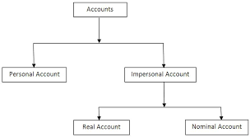

Slide 11
IMPERSONAL ACCOUNTS
All accounts which are not personal are impersonal accounts. It can be divided into sub part.
( a ) Real Account
Which accounts are related to goods, assets of business.
(i)Goods which are not for trading purpose are called assets i.e building , machinery , land, furniture, cash ,bank ,goods ,etc
(ii)Assets are divided into two types i.e tangible assets and intangible assets

Slide 12
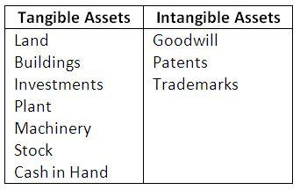
tangible assets and intangible assets
Tangible assets are physical assets
Intangible assets are nonphysical assets

Slide 13
(b) Nominal accounts
These accounts are related to all types of revenue expenses and income

Slide 14
Personal Account | Real Account | Nominal Account
If the a/c head relates to any person or artificial person. In final a/c such personal a/c are located only in balance sheet. Personal a/c implies any resemblance with name of any person | Real a/c deals with assets Fixed tangible assets (see, feel ,touch) & fixed intangible assets (documents & promise) Real a/c appears in balance sheet on assets side. It never appears in trading & p/l a/c | All Expense Accounts All Income Accounts Trading Account Profit & Loss Account
If the amount is receivable from any person eg debtors or If the amount is payable to any person eg creditors, Then such personís a/c is personal a/c. | Fixed tangible Assets Land & Bldg Plant & Machinery Furniture & Fixtures Vehicles & Equipments Computer Livestock | Expenses Purchases Wages Inward expenses Factory Expenses Administrative Expenses Selling & Distribution Expenses

Slide 15
REPRESENTATIVES A/C Outstanding expenses (expense payable) Pre received income Prepaid income/expense paid in advance Outstanding income | FIXED INTANGIBE ASSETS Goodwill Patent Copyright Trademark Licenses Franchises | Outward Expenses Interest paid on Loan given Depreciation All Losses Bad Debts Discount Allowed.
BUSINESS HAS TO RECEIVE FROM OR PAY TO | Cash Bills Receivable Investments. Stock of Goods is a real a/c (see feel touch) | Income Sales Rent received Commission Received

Slide 16
Thank you

