Slide 1


Dr G.B.Lamb
Head, Department of Mathematics B.P. College,Kinwat

Slide 2
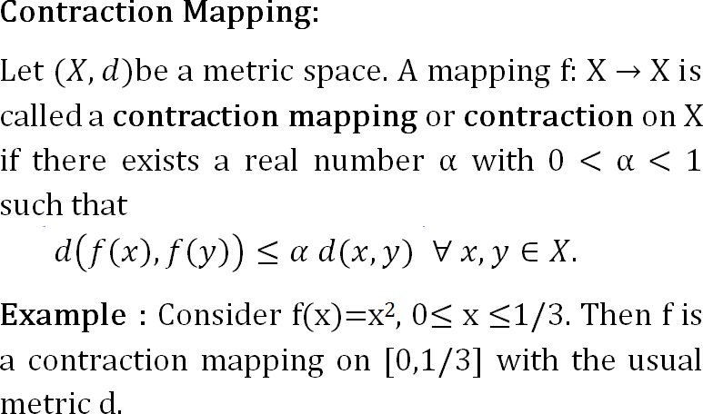

Slide 3
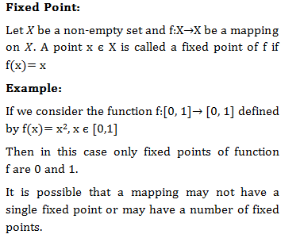

Slide 4
Banach Contraction Principle :
The following is a well-known result in analysis commonly known as ‘Contraction Mapping Principle’ or ‘Banach Fixed Point Theorem’, it has
extensive analysis.
applications Moreover,
in various branches of the contraction mapping
principle has simple statement and elegant proof. Stefan Banach ( 1892-1945 ) was the famous Polish Mathematician who was one of the founder of fixed point theory. In 1922 Banach prove fixed point important result on contractive type mappings.

Slide 5
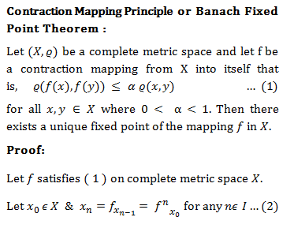

Slide 6
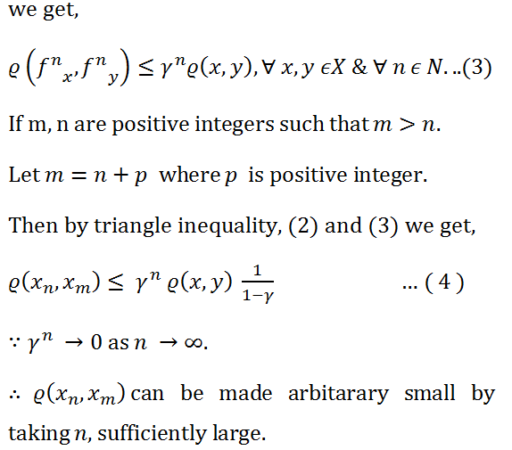

Slide 7
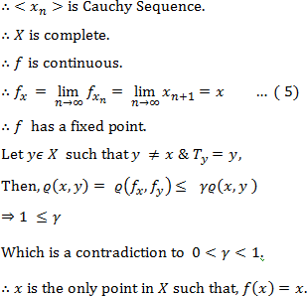

Slide 8
