Slide 1
Metamerism in annelids
Meaning of Metamerism:
Metameric segmentation or metamerism is an architectural body plan in some animals in which the similar body segments and organ systems are serially repeated one after another. The similar body segments are called metameres or somites.
The animals which exhibit such features called metamerically segmented. Structurally each meta-mere or somite is constructed on the basis of some fundamental plan and usually possesses a part of almost all the body systems.

Slide 2
Occurrence of Metamerism
Metamerism is first seen in annelids in animal kingdom. Each segment usually con­tains appendages, muscles, nerves, blood vessels, excretory organs and a pair of coelomic sacs which are repeated in almost all segments. It is also seen in kinorhynchs, arthropods and most chordates
i) Annelid and arthropod line,
(ii) Chordate line and
(iii) Cestode line.

Slide 3
Characteristic Features of Metamerism:
Metamerism is always confined to the intermediate (trunk) segments except the anterior acron (head) and a poste­rior pygidium or telson.
. Each metamere represents a mirror image of the other.
Segmental structures are interdepend­ent on each other.
. They are integrated into a single func­tional unit.
. All the segments of body work in co­ordination.

Slide 4
Types of Metamerism
1. True Metamerism:
The true metamerism is one in which the segmentation of the body develops by the segmentation of the mesoderm. It occurs in annelids (Fig. 17.14), arthropods and in most chordates. The body of annelids consists of a number of segments and the number re­mains constant in a particular species except in certain cases of asexual reproduction. New segments are not added to the body after maturation.

Slide 5
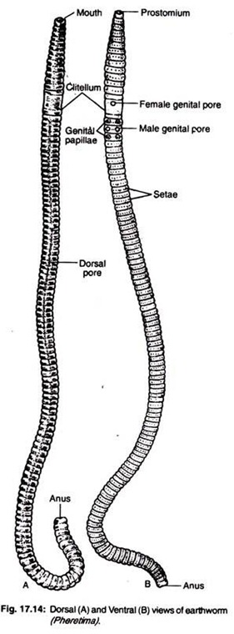

Slide 6
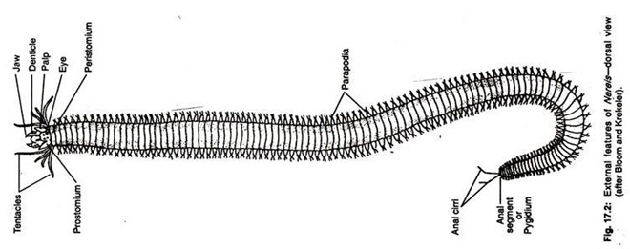
2. Homonomous Metamerism:
If the segments or somites of the animal are all alike, the’ segmentation is called homonomous metamerism. It is seen in annelids (Fig. 17.2). Each metamere contains segmental blood -vessels, nerves, nephridia and coelomoducts. This is a primitive type of segmentation and is not found in any exist­ing animal because a few anterior segments are specialised to form the head which is called cephalization.

