Slide 1
Baliram patil college kinwat, nanded
Dept. Of Zoology
Topic : Phylum echinodermata
Presented by:mr.Pradip Laxman Rudraswad

Slide 2
Content:
Phylum -Echinodermata
General feature or charcterstic
Classification upto class level

Slide 3
General Charcterstics and classification
The echinoderms are exclusively marine and are among the most common and widely distributed of marine animals.
They occur in all seas from the intertidal zone to the great depths. Symmetry usually radial, nearly always pentamerous.
Body is triploblastic, coelomate with distinct oral and aboral surfaces and without definite head and segmentation.
They are of moderate to considerable size but none are microscopic. Body shape rounded to cylindrical or star-like with simple arms radiating from a central disc

Slide 4
Endoskeleton consists of closely fitted plates forming a shell usually called theca or test or may be composed of separate small ossicles.
Coelom is spacious lined by peritoneum, occupied mainly by digestive and reproductive systems and develops from embryonic archenteron, i.e., enterocoel.
Presence of water vascular or ambulacral system is the most characteristic feature. It consists of tubes filled with a watery fluid.
Alimentary tract is usually coiled tube extending from the mouth located on the oral surface to the anus on the aboral or oral surface.

Slide 5
Classification
Subphylum I. Pelmatozoa
Mostly extinct echinoderms
Body is attached by the aboral surface or by an aboral stalk.
Mouth and anal aperture present on the oral surface facing upwards.
. Viscera is enclosed in a calcareous test.
Tube feet or podia are primarily food catching and devoid of suckers.
. Main nervous system is aboral,. Pelmatozoa has only one living
Class 1. Crinoidea:
1.Both extinct and living forms.
2. Living members are without stalk and free moving but extinct forms attached by a stalk.
3. Body consists of an aboral cup, the calyx and oral cover or roof, the tegmen and strongly pentamerous in structure.
4. Oral surface is directed upwards.
Ex.Antedon, Rhizocrinus, Metacrinus

Slide 6
Subphylum II. Eleutherozoa
1. Mostly living echinoderms.
2. Stem or stalk absent, usually free living forms.
3. Body structure usually pentamerous.
4. Oral surface bearing the mouth is downward or lying on one side.
5. Anus usually on the aboral surface.
6. Ambulacral grooves usually not for food gathering and the tube feet with suckers are chiefly locomotory organs.
7. Main nervous system is oral.

Slide 7
Class 1. Holothuroidea
Body bilaterally symmetrical, usually elongated in the oral-aboral axis having mouth at or near one end and anus at or near the other end. Body surface is coarse.
Endoskeleton reduced to microscopic spicules or plates embedded in the body wall.
Mouth surrounded by a set of tentacles attached to water vascular system.
Podia or tube feet are usually present and locomotory.
Alimentary canal is long and coiled and cloaca usually with respiratory trees.
Sexes are usually separate and gonad single or paired tufts of tubules
Commonly called sea cucumbers
Ex.Thyone, Cucumaria, Phyllophorus

Slide 8
Class 2. Echinoidea
General feature
Body is spherical, disc-like, oval or heart- shaped.
Body is enclosed in an endoskeletal shell or test of closely fitted calcareous plates covered with movable spines.
Outer calcareous plates are distinguished into five alternating ambulacral and five inter-ambulacral areas.
Podia or tube feet come out from the pores of ambulacral plates and are locomotory in function.
. Mouth is centrally placed on the oral surface and surrounded by a membranous peristome. Anus is located at the aboral pole and surrounded by membranous periproct.
Ambulacral grooves are absentPedicellariae are stalked

Slide 9
Subclass I. Bothriocidaroida:
Each inter-ambulacral is with single row of plates
. Madreporite radially placed. Typical lantern absent.
. Includes a single extinct Ordovician genus.
:
Example :Bothriocidaris.

Slide 10
Subclass II. Regularia
Body is globular, mostly circular and sometimes oval in shape.
. Symmetry is pentamerous with two rows of inter-ambulacral plates.
. Mouth is centrally located at the oral surface and surrounded by peristome.
Anus is centrally placed at the aboral pole surrounded by periproct.
Aristotle’s lantern is well developed. Madreporite is ambulacral.
Ex Phormosoma, Sperosoma.

Slide 11
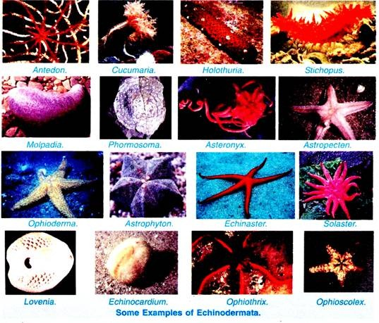

Slide 12
Subclass III. Irregularia
Test is mostly flattened oval to circular.Symmetry is bilateral.
Mouth centrally placed on the oral surface.
Anus is displaced posteriorly generally marginal at oral or aboral surface and lies outside the apical system of plates.
Podia or tube feet are not locomotory
Ex.Clypeaster, Laganum.

Slide 13
Class 3. Asteroidea
Body is flattened, pentagonal or star- shaped.
Oral and aboral surfaces are distinct, the oral surface directed downwards and aboral surface upwards.
. Five to fifty long or short rays or arms radiating symmetrically from a central disc.
Mouth is centrally placed at the oral surface surrounded by a membranous peristome.
Anus is small and inconspicuous located more or less eccentrically on the aboral surface.
Ambulacra form prominent grooves provided with podia or the feet.
Development includes bipinnaria or brachiolaria larva.
Commonly called starfishes or sea star
Ex.Brisingaster, Heliaster, Zoraster, Asterias

Slide 14
Class 4. Ophiuroidea
Body is flattened with a pentamerous or rounded central disc.
Oral and aboral surfaces are distinct.
Arms usually five rarely six or seven are long, slender, smooth or spiny.
Ambulacral grooves are absent.
Anus and intestine are absent.. Madreporite is on the oral surface.
Sexes are separate, gonads pentamerous. Burase usually
Development includes a free swimming pluteus larva.
10. Commonly called brittle stars.
Ex. Asteronyx, Astrophyton, Astoporpa

